Slide 1
Data processing for tumor and t-cell detections
Yannis laaroussi
Bachelor thesis – initial presentation

Slide 2
motivation
Link between biology/medicine and computer science
Learn python
Manipulate data

Slide 3
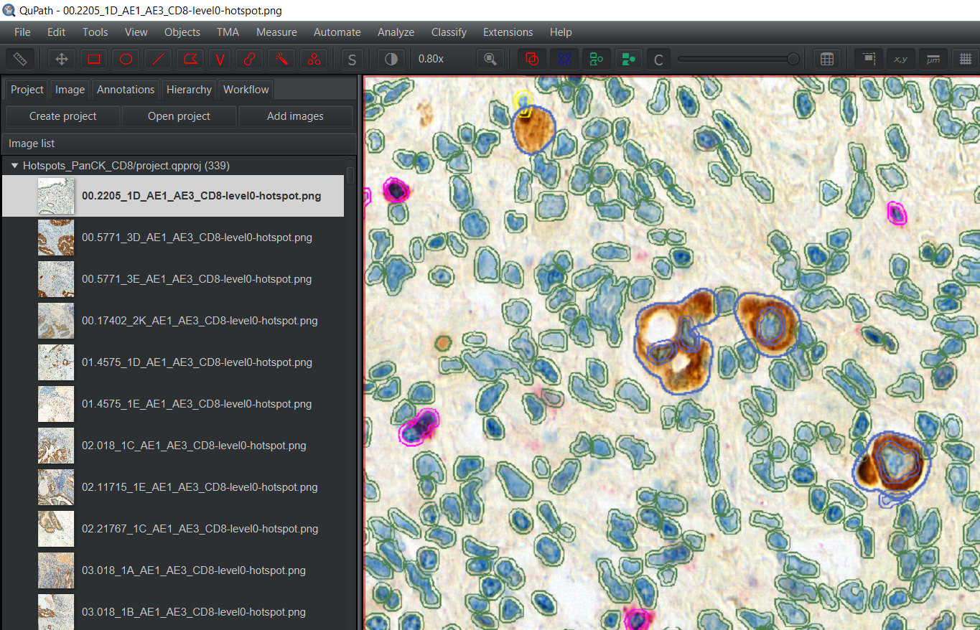
qupath
Tumor buds
(brown spot)
Bounded by polygons

Slide 4
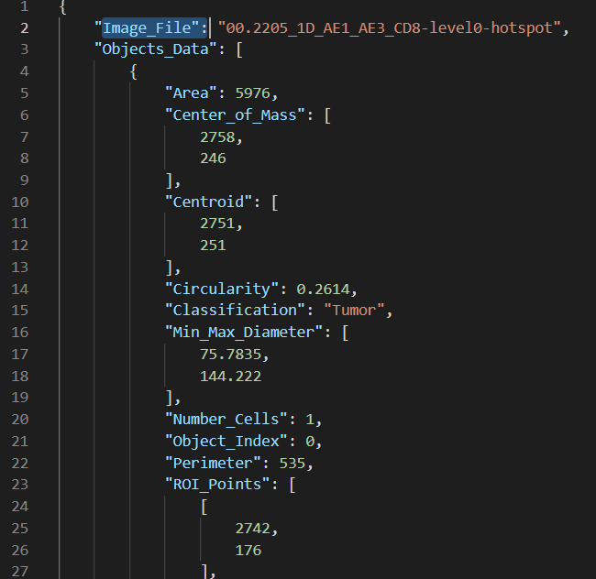
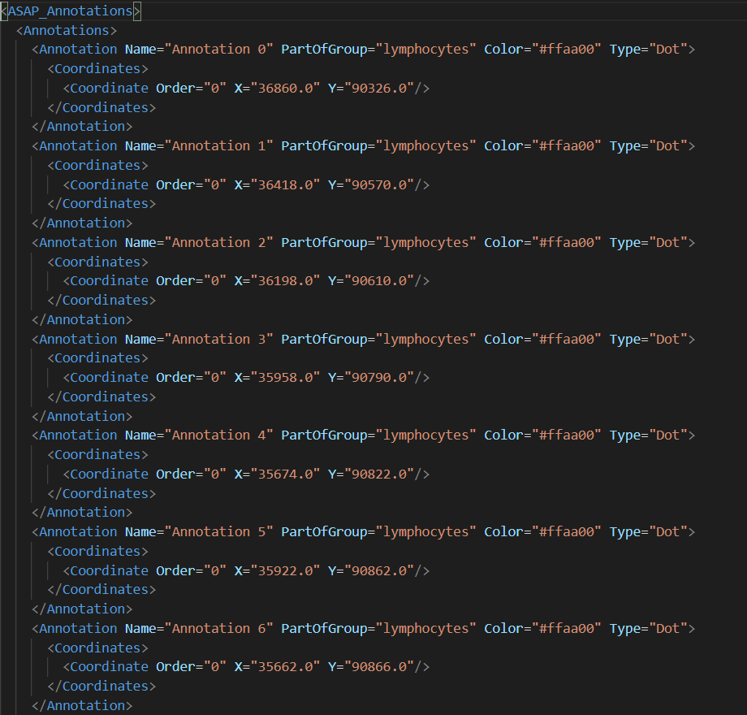
goal
JSON file (from QuPath)
XML file
Python Script

Slide 5
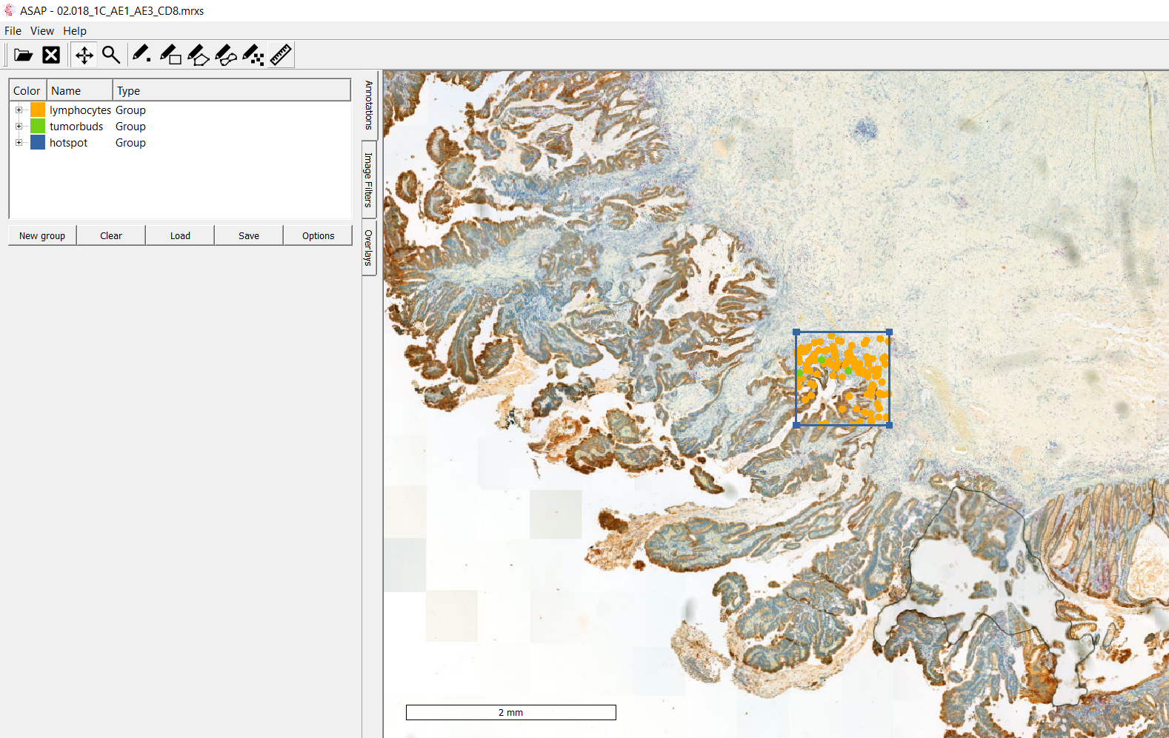
Asap
Visualisation using xml file

Slide 6

excel
JSON file to .CSV
Python Script

Slide 7
Timeline
Preparation/Introduction to the subject | 21.02.2022 – 06.03.2022 | 3 weeks
Part 1 : JSON to XML | 07.03.2022 – 27.03.2022 | 3 weeks
Part 2 : JSON to EXCEL | 28.03.2022 – 24.04.2022 | 4 weeks
Part 3 : Writing | 25.04.2022 – 22.05.2022 (+ summer if needed) | 4 weeks

Slide 8
Questions ?

